Slide 1
Advanced SQL Server Database
SQL Server Reporting Services

Slide 2
Lesson Objectives
Identify which components of SQL Server exist to deliver reports
Describe the lifecycle of a report
Use Analysis Services with Reporting Services to deliver ad hoc reports
Use SSDT to create a report server project
Describe how to deploy reports to the report server

Slide 3
Making Your Data Useful
We've spent a lot of time working with databases, performance tuning, and data
Now we want to make sure that the data from SQL Server is available to an end user so that he or she can view it
Example:
Your manager, coworker, or client has requested to see the data in particular tables or views in the database. We would like to make that data viewable in an attractive easy-to-read format.

Slide 4
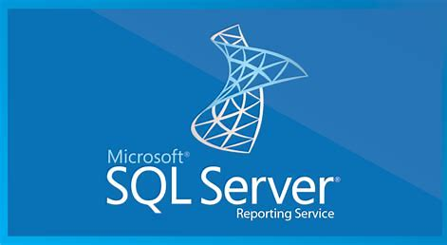
SQL Server Reporting Services
SQL Server Reporting Services is
Also called SSRS
Is a service that ships with SQL Server
“Is a server-based reporting platform that provides comprehensive reporting functionality for a variety of data sources.“

Slide 5
SQL Server Reporting Services
Microsoft also says this about SSRS:
Includes a complete set of tools for you to create, manage, and deliver reports
Includes APIs that enable developers to integrate or extend data and report processing in custom applications
Reporting Services tools work within the Microsoft Visual Studio environment and are fully integrated with SQL Server tools and components

Slide 6

Reporting Tips
There are a few tips that you would want to keep in mind when creating reports
Use just the right amount of data
Aim for complete but concise with not too little or too much data
Make it appealing
The report needs to be pleasing to the eye

Slide 7
Reporting Services 101
If someone has asked you to view the data in your database, that is a request for a report
Reporting Services has two different ways to generate reports
Reports generated in SQL Server Data Tools: You can create simple reports using drag-and-drop functionality or you can design fairly robust reports with code.
Reports generated from BI Semantic Models: This is making use of a relatively simple, web-driven interface that is meant to allow end users to create their own simple reports. Creating the models relies on SQL Server Analysis Services.

Slide 8
Reporting Services 101
Although generating reports with SSDT uses a different architecture than those generated from Business Intelligence Semantic Models, they are eventually run from the same Reporting Service web host.

Slide 9

The SSRS Lifecycle
The broad strokes of the SSRS lifecycle are:
First you need to develop reports (or report models, as we’ll see)
Then you need to organize and secure them
Finally you’ll want to see those reports delivered to end users.

Slide 10
#1 – Developing Reports
Reports have the file extension of .rdl
RDL (Report Definition Language) is an XML-based format that represents the definition of an SSRS report. An RDL file describes layout, data mapping, and all the information the report server needs to fetch data and render the report.

Slide 11
#1 – Developing Reports
Each RDL needs at least one data source to draw from, and each data source needs a query or a stored procedure to run.
As a report developer, you may find yourself creating tabular models (using SQL Server Analysis Services) as well.
An SSAS tabular model is a defined set of tables or views with clear relationships, from which an end user can create useful ad hoc reporting.

Slide 12
#2 – Managing Reports
You can’t get much out of a report without trying out a deployment and a report model is not useful until it’s deployed.
Management can mean multiple tasks but at the least it means the following:
Deploying reports to the report server
Implementing security to provide access to specific users

Slide 13
#3 – Delivering Reports to Users
The model or RDL that you have created is a template that tells SSRS where to get the data and how to organize it, but it doesn’t actually contain the data.
Running a report and making the completed output available to users is the last phase.
Reports can be run manually, but you can also set them up to run on a defined schedule and then send the results to a subscriber list.
SSRS reports can be viewed through different viewers depending on how they’re rendered; you can send a rendered report to Word, Excel, PDF, or its native Report Viewer format.

Slide 14


Reporting Services Architecture
There are many components that come together to make SQL Server Reporting Services

Slide 15
Reporting Services Architecture: SSDT: Report Designer
The part of SQL Server that will help you create reports and report models is the SQL Server Data Tools (SSDT).
Like Integration Services, Reporting Services uses this lightweight version of the Visual Studio IDE to provide you with the tools and wizards that you need to develop solutions

Slide 16
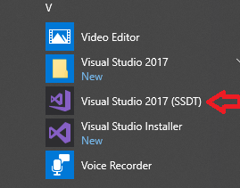
Reporting Services Architecture: SSDT: Report Designer
The product of your report development in SSDT will be SSRS reports are usually stored as RDL files
When you deploy an RDL file to the report server, it gets stored in the report server database for use by the rendering engine.

Slide 17

Reporting Services Architecture: SSRS Windows Service
The rendering engine in SSRS can be found running as a Windows service called SQL Server Reporting Services (unless you’re in SharePoint integrated mode).
SSRS Windows Service is responsible for
Rendering
Data processing
Delivery
Security
This service is the heart of SSRS

Slide 18
Reporting Services Architecture: Report Manager
Report Manager is a browser-based tool that acts as the interface to all the reports, data sources, and other user-created elements on the report server.
Report Manager is used to do the following tasks:
Upload objects to the report server
View reports
Create or edit reports with the Report Builder
Browse or edit data sources
Set up report-level security
For the most part, Report Manager is what you would use any time you need to interact with content you’ve created.

Slide 19
Reporting Services Architecture: Report Builder
New feature!
Starting with SQL Server 2012, there is a greater emphasis on giving users the tools to build their own reports.
Report Builder is the tool to allow users to build their own reports
How?
Report Builder works with RDL files, so it can edit any report, even one created in SSDT.
But Report Builder can also take a good semantic model (we’ll see this soon) to create powerful reports using wizards and visual editing tools.
Not just developers can do this, “super” users (users a little more IT-savvy) can do this too

Slide 20
Reporting Services Architecture: Report Viewer
The Report Viewer is a control available in Visual Studio that allows you to view the reports you or others have created.
It can run in either remote or local processing mode
Remote - lets the report service do the work
Local- performs the rendering in the control

Slide 21
Building Simple Report Models
Beginning in SQL Server 2012, you can build what is called Business Intelligence Semantic Model.
Why?
The big idea is that a developer can create the model and it then allows many types of reports to be created from that one model.
Reports can be created from that model by users instead of only limiting development to be done by developers (i.e. “programmers/analysts”).
How?
Report Models are created using SQL Server Analysis Services.
Therefore SSAS has to be installed and available for the next steps

Slide 22
Creating a Project
After you have an instance of SSAS in tabular mode, you can then create a project. Open SQL Server Data Tools and then File->New Project
Select Analysis Services as the template type and then choose Analysis Services Tabular
Choose an appropriate project name and click OK.

Slide 23
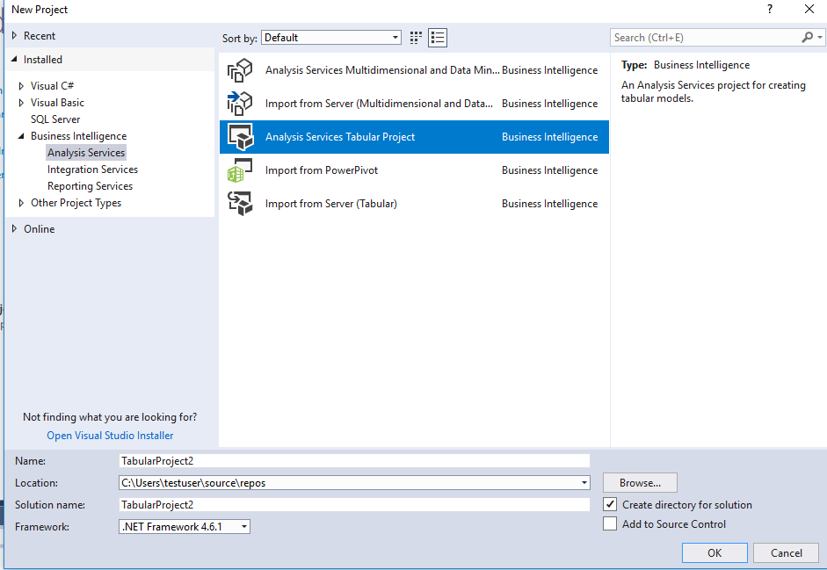
Creating a Project

Slide 24
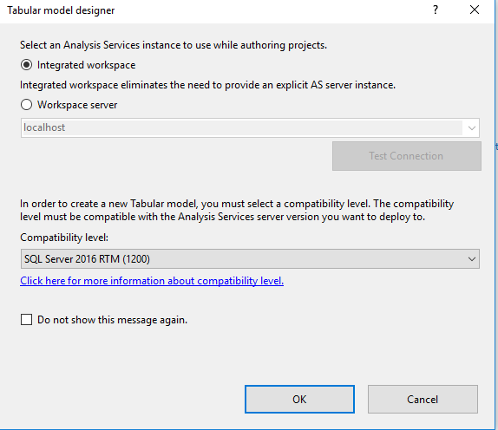
Creating a Project
Select Integrated workspace

Slide 25
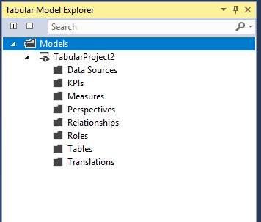
Adding Data to Your Model
At this point, we should see the Solution Explorer on the top-right side containing our empty BI Semantic Model
The next step is to start adding entities to your model.

Slide 26
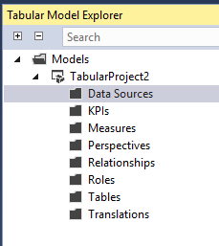
Adding Data to Your Model
Right click on Data Sources and select Import from Data Sources.

Slide 27
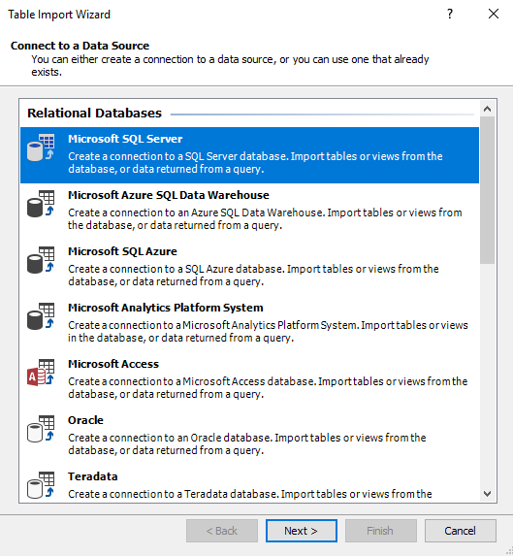
Adding Data to Your Model
Step #2 - Choose data source of Microsoft SQL Server. Note that you can connect to other data sources such as Oracle.

Slide 28
Adding Data to Your Model
Next you are presented with a dialog box for which you need to specify some information.
Friendly connection name: This is the moniker you’re going to apply to this connection going forward.
Server name: This is where you identify the server you want to connect to for this connection
Windows/SQL Server authentication: Here you choose the authentication type to connect to your server.
Connect to a database: Here you select a database on the server you have chosen.

Slide 29
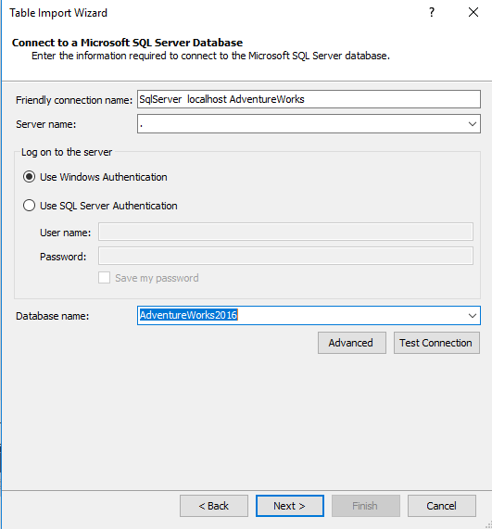
Adding Data to Your Model
Specify values as defined here.
The value of ‘.’ refers to local host
Connecting to AdventureWorks
Test

Slide 30
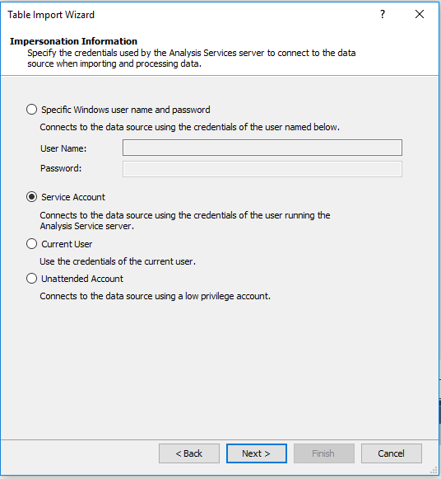
Adding Data to Your Model
You are next prompted for the credentials of the account used by Analysis Services to the connect to the data source.

Slide 31
Adding Data to Your Model
The next step is specifying how to get your data.
You can do one of the following:
Select from a list of tables and views to choose the data to import
Write a query that will specify the data to import

Slide 32
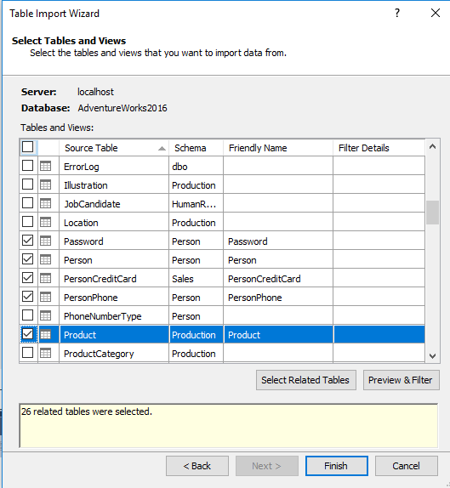
Adding Data to Your Model
Steps #7-#9: The screen you are presented with next looks like the following.
Clicking the “Select Related Tables” button is used in the steps to bring in the SalesOrderHeader table. This button checks for tables with a relationship to the selected table(s).
Let’s add the Customer, Person, and Products tables.

Slide 33
Adding Data to Your Model
You can preview and filter your data by clicking the “Preview & Filter” button.
This gives you a chance to narrow the data you’re going to import from the Customer table, for example.

Slide 34
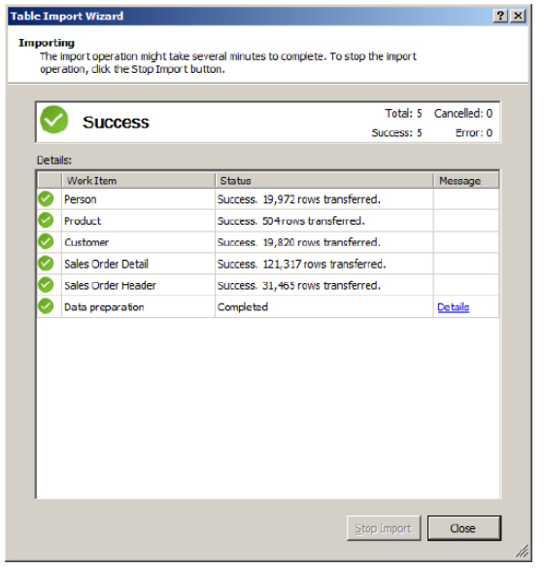
Model Complete
After this step, your model is complete.

Slide 35
The Next Steps of Model Creation
The next steps are:
Use the Model Designer to manipulate relationships between objects in data source views
Show how to add a computed column
Add sum and average to a measures grid
Add security to specify who should be able to access the data in your model
Access is granted to the roles you create, and the users who are members of those roles can see any rows to which the role has access.

Slide 36
The Next Step of Model Creation
We will stop here with the exercise as it is not required for the class.
Our objective is to understand what SQL Server Reporting Services is and how it can be used by an organization.
The second objective was to know where to begin if you needed to create a report.
There are entire books written on SSRS.

Slide 37
Building and Deploying Your Data Model
To make your model usable to end users, you must deploy it.
To deploy, simply drop down the Build menu and choose Deploy. You can watch its progress in the Deploy window that pops up
Once complete, the tabular model is now deployed to your tabular-mode instance of SQL Server Analysis Services.

Slide 38
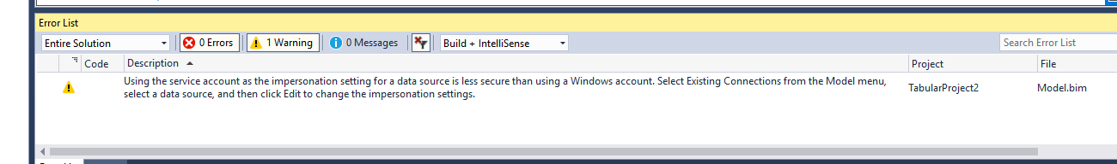
Building and Deploying Your Data Model
You will receive a warning that the impersonation setting for a data source is less secure than using a Windows account. This is fine for demonstration purposes. Note that there are no errors.

Slide 39
Report Creation
Your deployed tabular model is not a completed report.
A model instead enables the creation of reports using the model to represent the data.
Now that it is deployed, you can generate many reports from just the one model.

Slide 40
Report Creation
To see and generate reports you will leave SQL Server Data Tools and actually visit the reporting user interface (Report Manager) at the following link
http://<your reporting server host>/reports
Note that on our virtual machine for the class, the default path is http://desktop-dhd3ecj/Reports

Slide 41
SQL Server Reporting Service Configuration
Before we go on to see what Reporting Services can do, we need to pause and mention that Reporting Services has a configuration tool.
This tool as well as configuration files are important to know about since we may need to tweak the configuration settings before we can access the site.

Slide 42
SQL Server Reporting Service Configuration
To access the configuration manager for Reporting Services, look under your programs accessible from Windows Start button
On Windows 10, it is found under the Microsoft SQL Server 2016 folder.

Slide 43
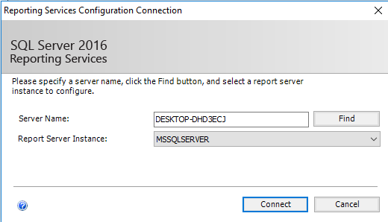
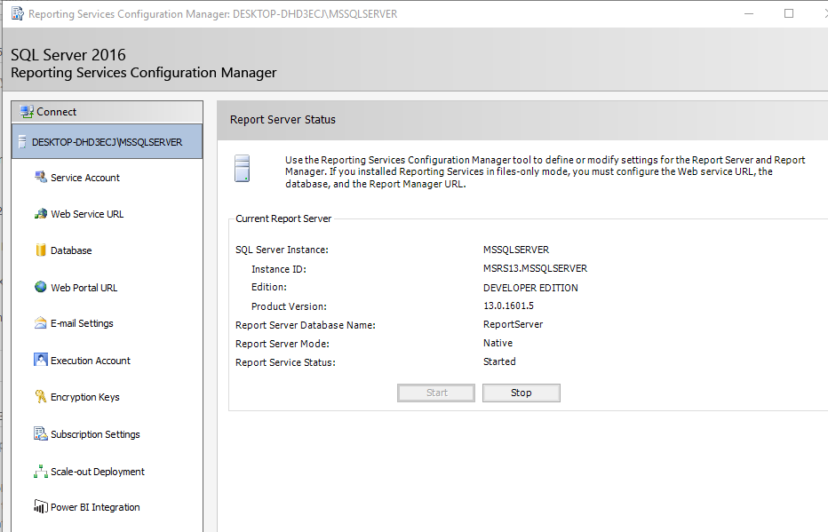
SQL Server Reporting Service Configuration

Slide 44
Report Creation
The report itself can be created by a developer, but can be other users as well.
From the web site, you can access a tool called Report Builder
Report Builder allows the creation of reports and has a user-friendly easy-to-navigate interface
Once the report it created, it will also need deployed

Slide 45
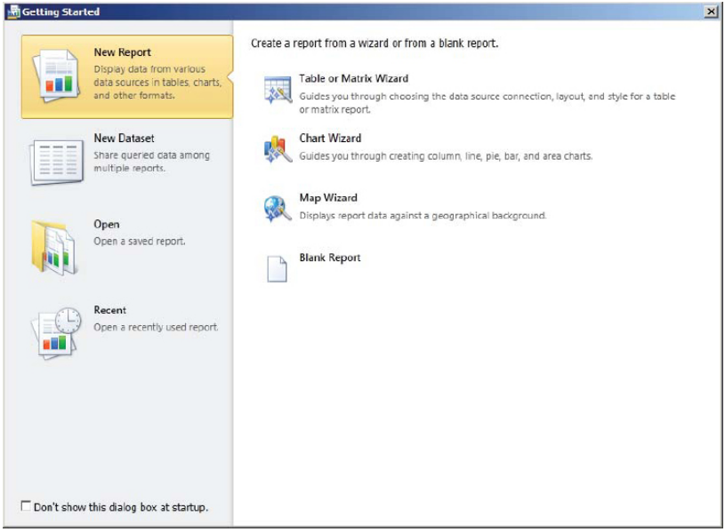
Report Creation

Slide 46
Summary
Reporting Services is a reporting server and makes professional reports available to users that need them
I’ve really only touched on the steps needed to create a report
There is so much more that you can do
For example you can parameterize reports, embed charts, integrate reports with other products (such as Microsoft SharePoint Services or Microsoft Office SharePoint Services), drill through from one report to another, and even embed reports inside of other reports.

